Slide 1
CUSTOMER BEHAVIOUR DATA ANALYSIS FOR BRITISH AIRLINES
Contributor: Sinan Bilir

Slide 2
Overview of Analysis
The analysis aims to evaluate customer sentiment towards British Airways by examining reviews from three different sources: TripAdvisor, Skytrax, and Airlineratings.com. The objective is to gain insights into how customers perceive various aspects of their experience with British Airways, including flight experience, service quality, and overall satisfaction. By conducting sentiment analysis and generating word clouds, we aim to identify common themes, sentiments, and areas of improvement based on customer feedback from these sources. Ultimately, the goal is to inform strategic decision-making and enhance customer satisfaction for British Airways.

Slide 3
Overview and Objective
Brief Overview: Our analysis aims to evaluate customer sentiments and perceptions of British Airways based on reviews from various sources.
Objective: To understand the overall satisfaction level, identify common themes, and uncover insights to improve customer experience and service quality.

Slide 4
Introduction of Data Sources
Data Sources:
1. TripAdvisor: User-generated reviews covering flight experiences with British Airways.
2. Skytrax: Comprehensive evaluations of airlines' products and services, including British Airways.
3. Airlineratings.com: Safety and product ratings, providing detailed analyses of airlines, including British Airways.

Slide 5
Summary of Reviews
- TripAdvisor: Mixed reviews ranging from positive flight experiences to complaints about service and lost luggage.
- Skytrax: Overall 4-star rating, but specific components under review. Highlighted issues in various classes.
- Airlineratings.com: Certified as a 4-star airline, but some components rated at 3-star levels. Assessments of different classes and product/service quality.

Slide 6
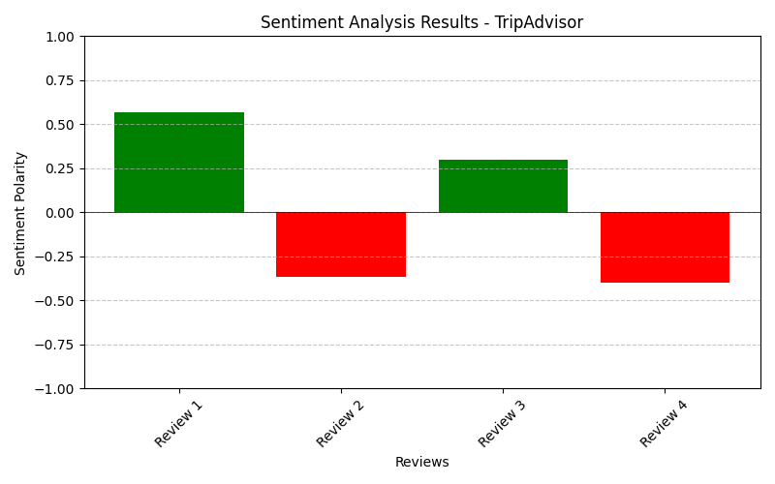
Sentiment Analysis
TripAdvisor Reviews
Great Experience: Positive sentiment (0.569). Passengers had a great experience with British Airways.
Disappointing Journey: Negative sentiment (-0.367). Some journeys left passengers disappointed.
Pleasant Surprise: Positive sentiment (0.3). Passengers were pleasantly surprised by certain aspects.
Unpleasant Experience: Negative sentiment (-0.4)/. Unpleasant experiences were reported.

Slide 7
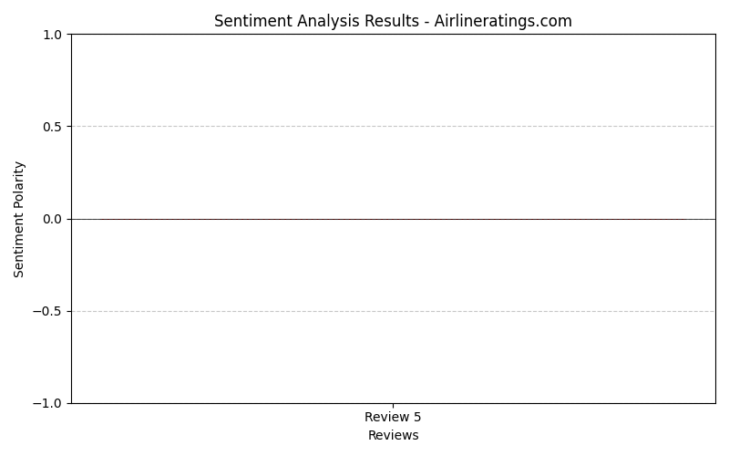
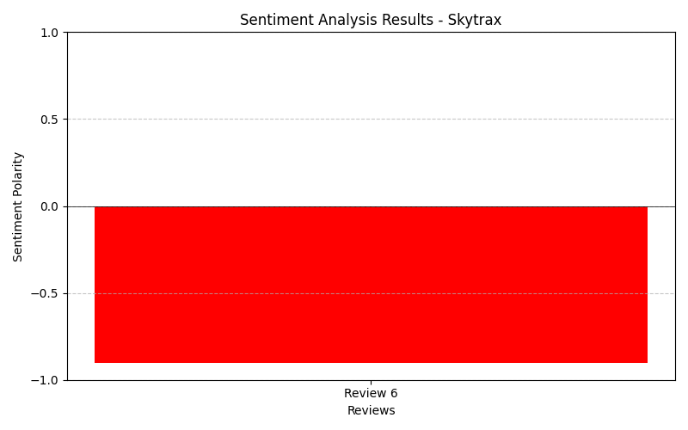
Skytrax Review
Critical Assessment: Predominantly negative sentiment (-0.9). Service standards and quality were criticized.
Airlineratings.com
Room for Improvement: Mixed sentiment (-0.006. Suggestions for improvement were highlighted.

Slide 8
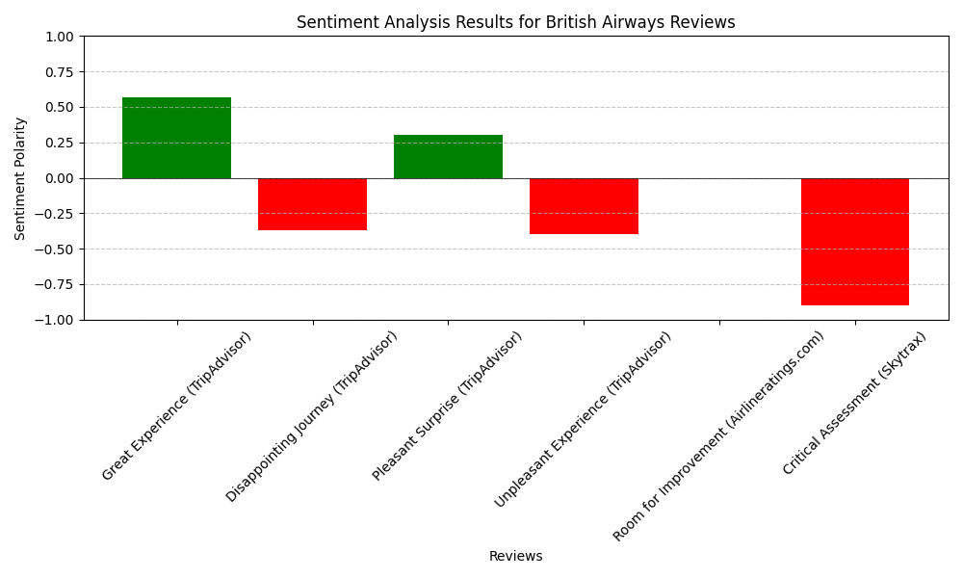
Insights and Recommendations
Address areas of concern highlighted by negative reviews.
Maintain positive aspects that passengers appreciate.
Continuously monitor feedback to enhance customer satisfaction.

Slide 9
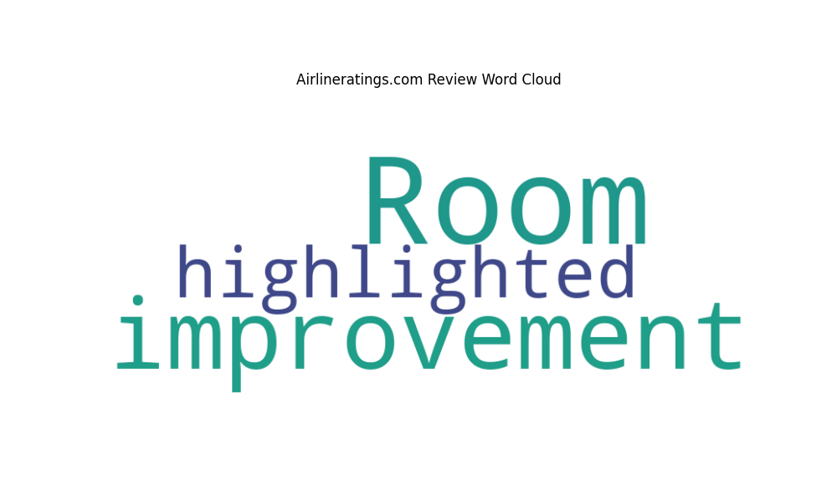
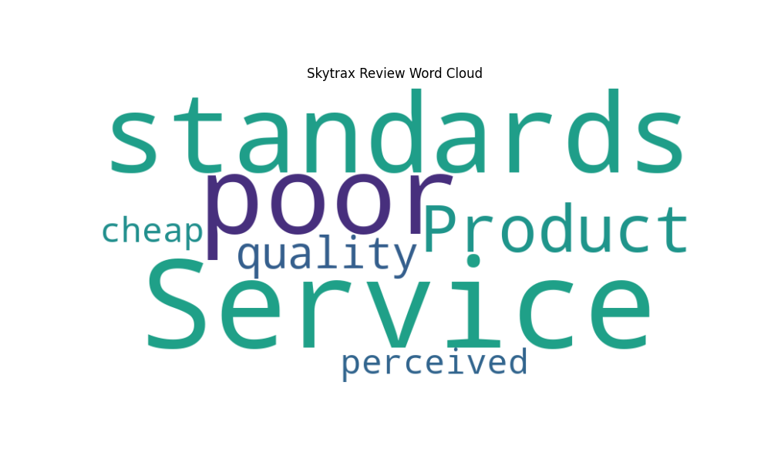
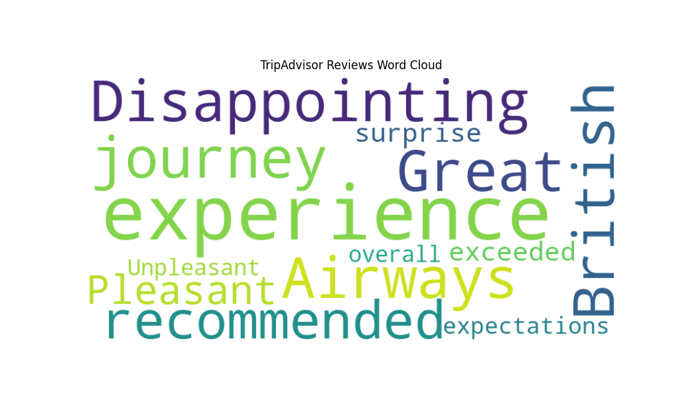

Word Cloud Analysis for British Airways Reviews
Word clouds visually represent the most frequent words in a given text dataset. Let’s explore the word cloud results from different sources to gain insights into customer sentiments about British Airways (BA).

Slide 10
Insights and Recommendations & Conclusion
1. TripAdvisor Reviews Word Cloud
Great Experience (TripAdvisor):
Positive words: “great,” “experience”
2. Airlineratings.com Review Word Cloud
Room for Improvement (Airlineratings.com):
Words: “improvement,” “highlighted”
3. Skytrax Review Word Cloud
Critical Assessment (Skytrax):
Negative words: “poor,” “cheap”
Insights and Recommendations
Address specific pain points highlighted in negative reviews.
Maintain positive aspects that passengers appreciate.
Continuously monitor feedback for ongoing improvements.
Conclusion
Understanding customer sentiments empowers British Airways to enhance its services and ensure passenger satisfaction. Let’s shape a better airline experience together! 🛫✨

Slide 11
THANK YOU! SINAN BILIR

